Slide 1
Variational Autoencoders
Discussion and an NLP Application
Kris Sankaran
Stanford Statistics

Slide 2
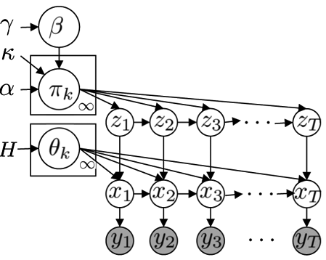
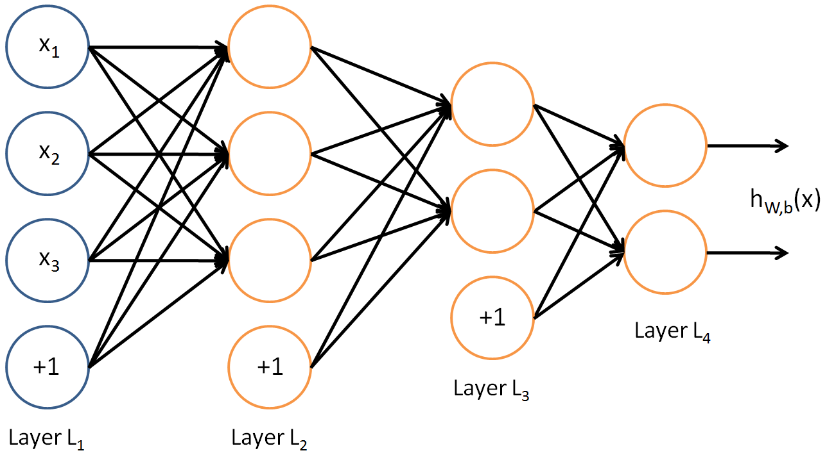
Probabilistic Inference ↔ Deep Learning
How can we blend,
Rich probabilistic models
Powerful deep learning
Describe generative process
Interpretable components
Quantify uncertainty
State-of-the art performance
Adaptable across problem types
Scales to large datasets

Slide 3
Probabilistic Inference ↔ Deep Learning
More fundamentally...
Develop methods for learning useful representations that are,
Powerful: Reflect complex structure in real data
Automatic: Don’t require substantial human effort
Modular: Easily assembled for new problems
Inferential: Allow reasoning about uncertainty

Slide 4
Plan
Variational Inference context
Variational Autoencoders
The Reparameterization Trick
Amortized Inference
Application: Sequence to Sequence VAE

Slide 5
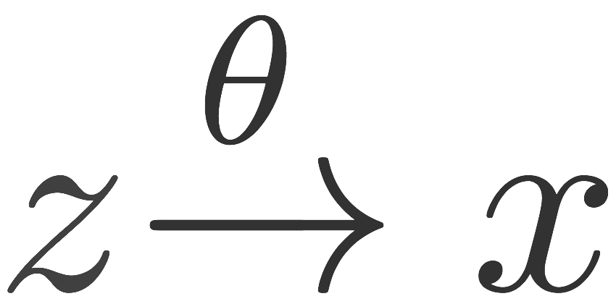
The Problem of Inference
It’s easy to reason about generative models

Slide 6
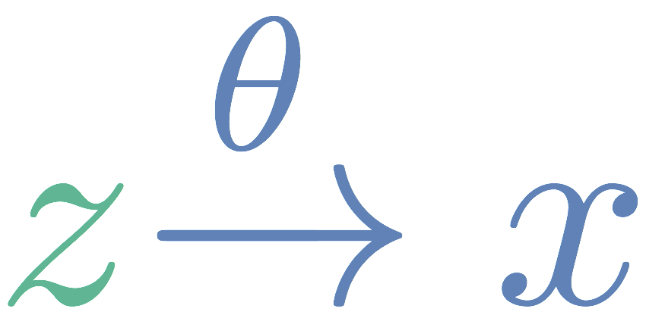
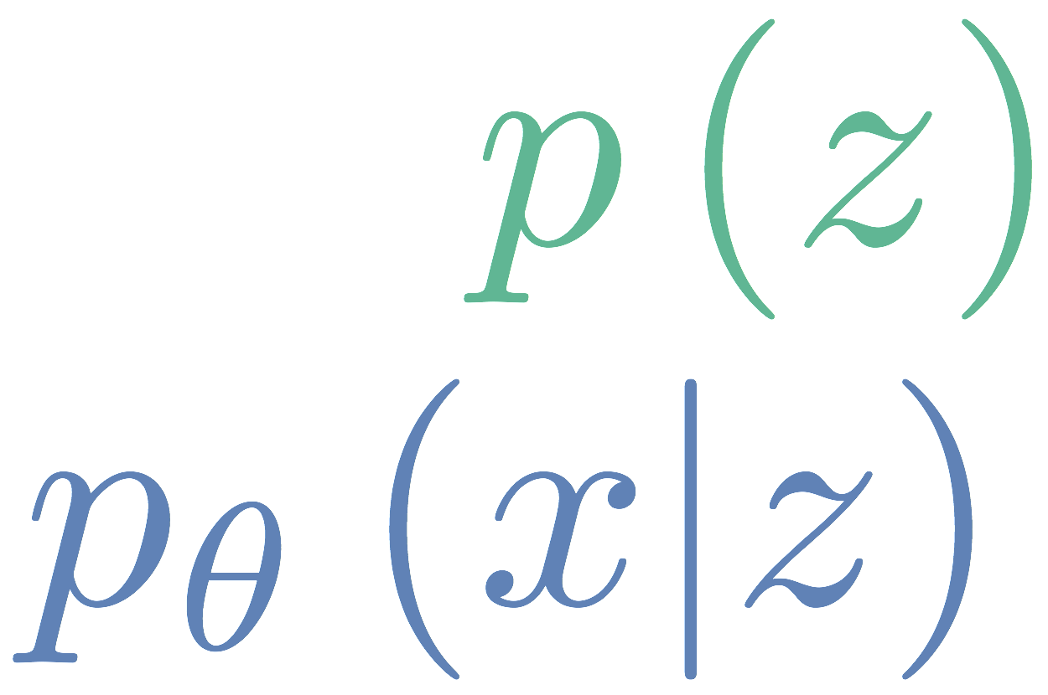
The Problem of Inference
It’s easy to reason about generative models
Latent representation -> Image
Latent representation -> Sequences
Physical equations -> Simulation
prior
likelihood

Slide 7
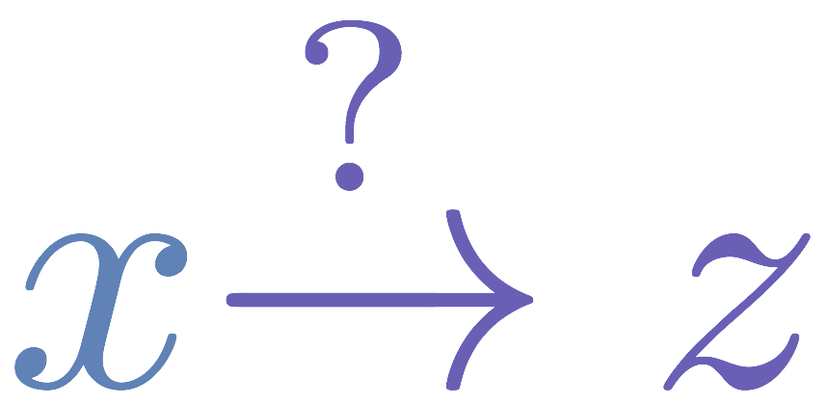
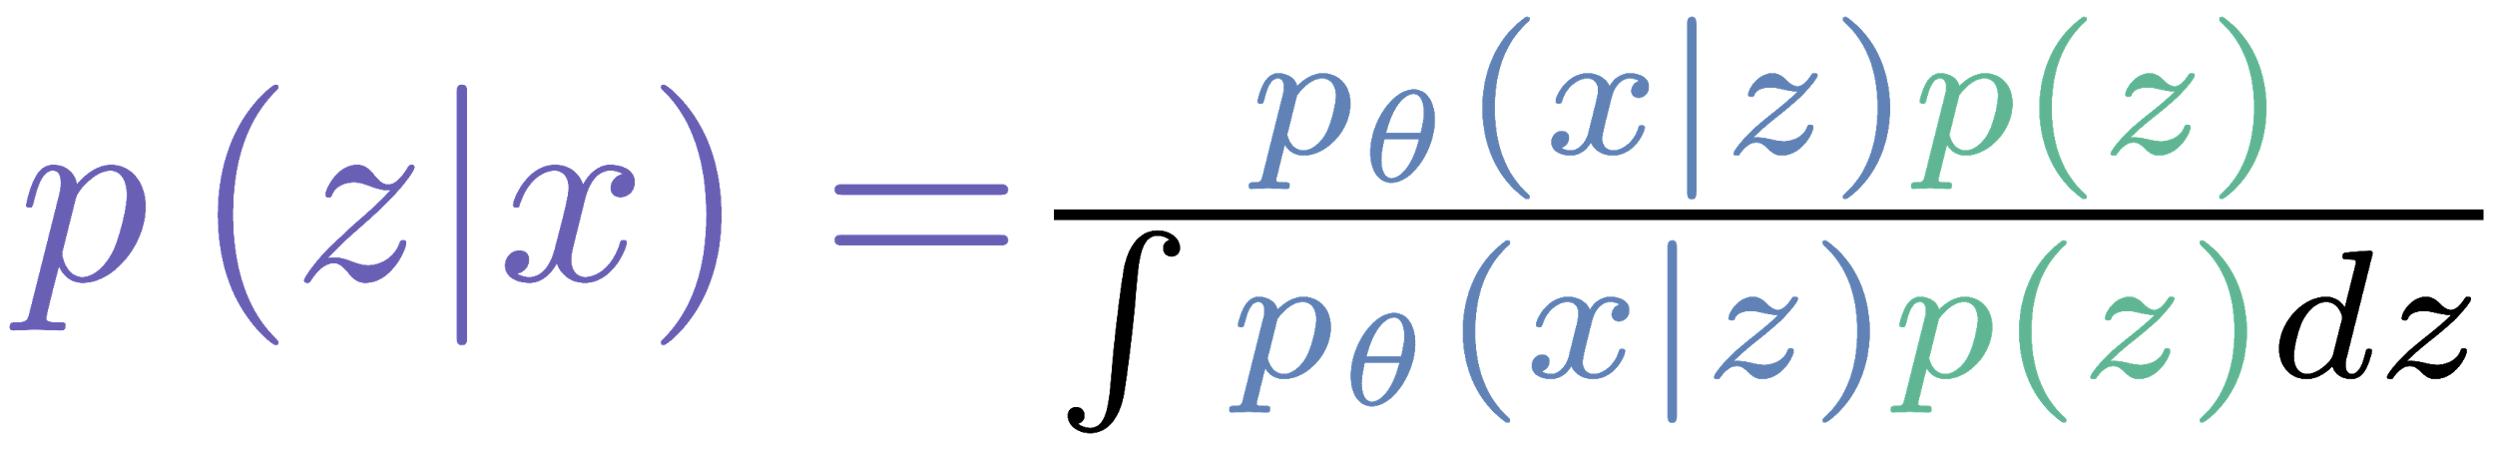
The Problem of Inference
What we want then is the reverse...
prior
likelihood
posterior

Slide 8
The Problem of Inference
What we want then is the reverse...
prior
likelihood
posterior

Slide 9
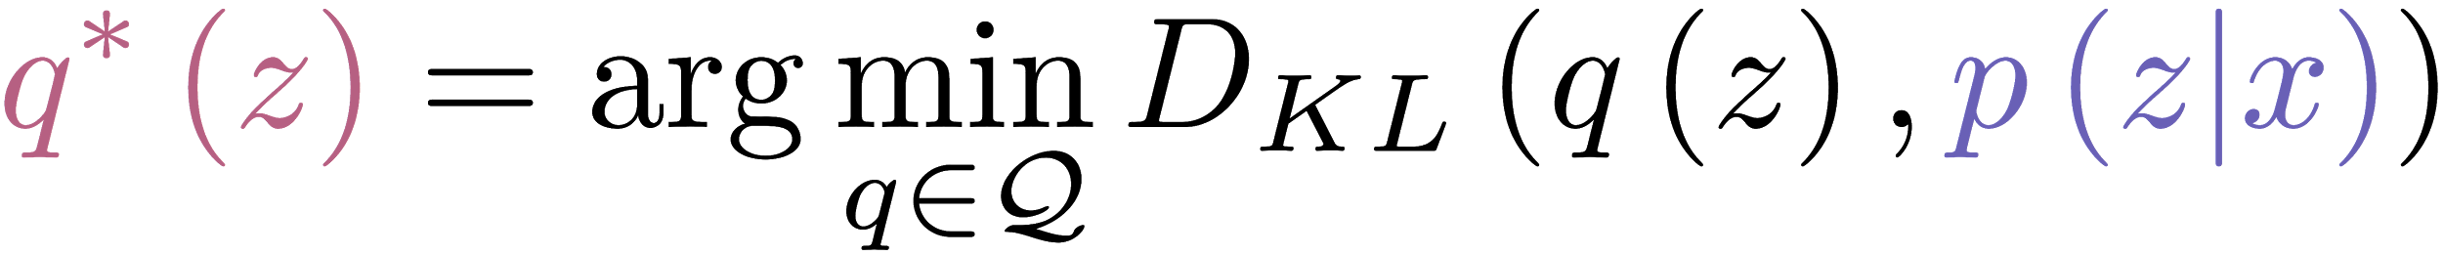
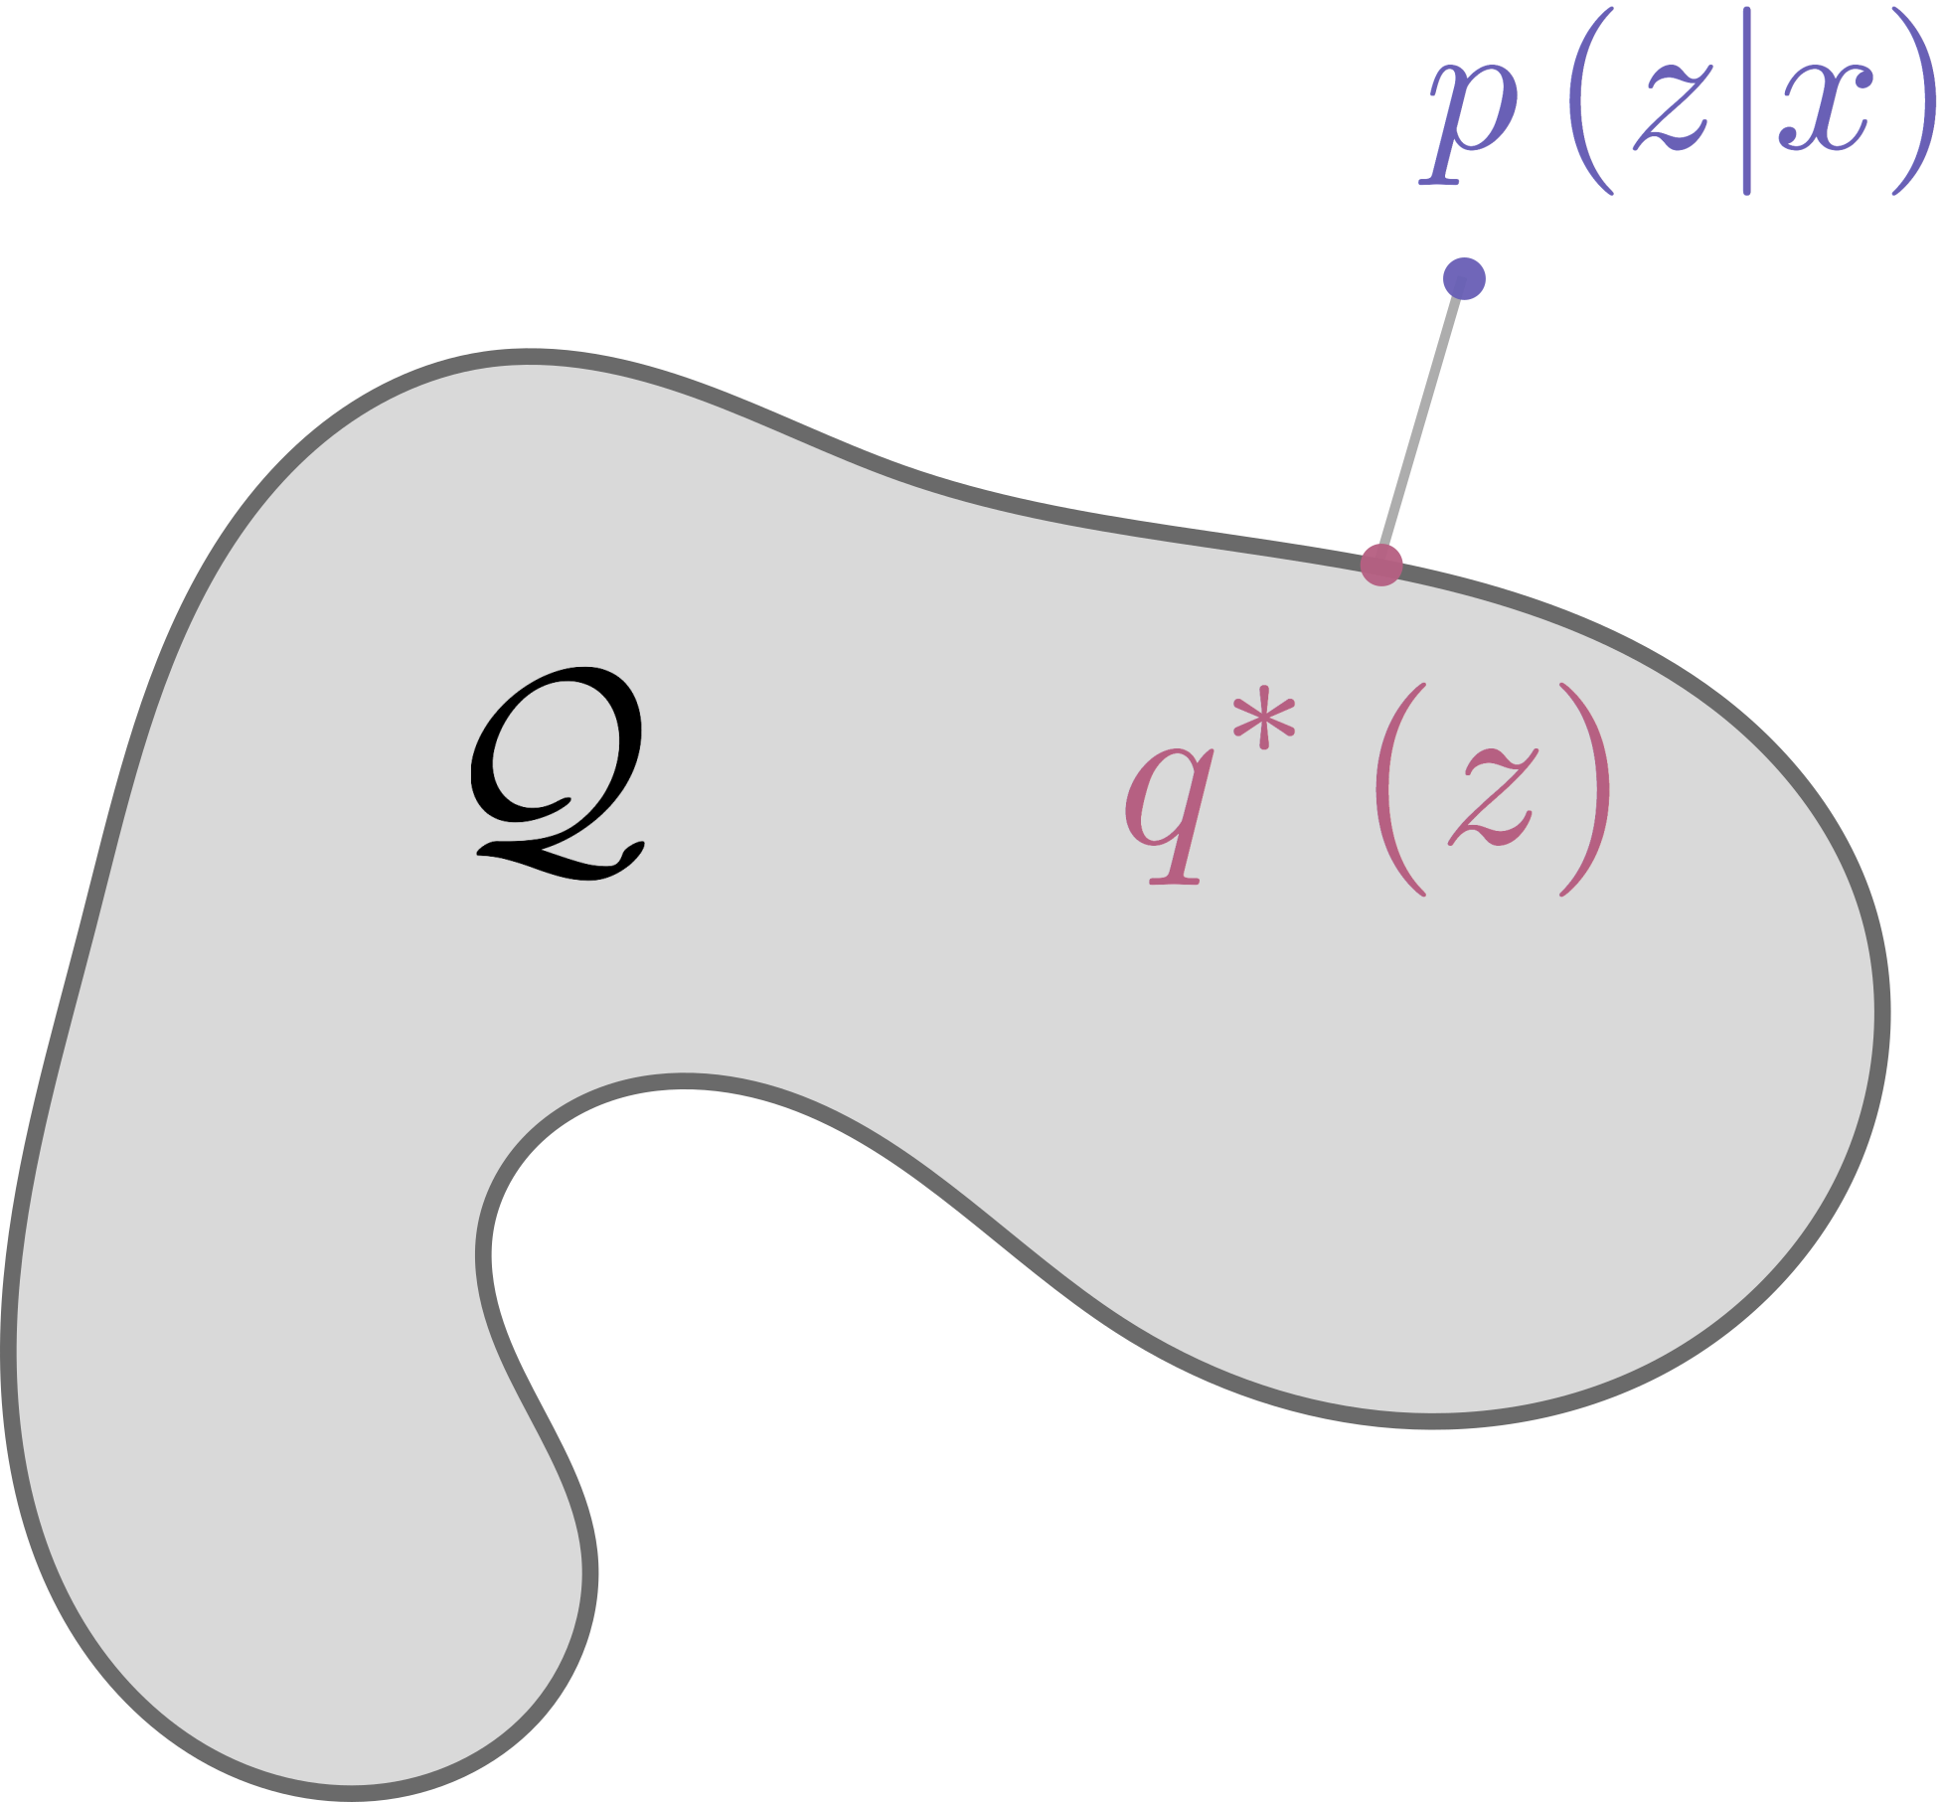

The Variational Idea
Integration → Optimization
Some families are easier to optimize over.
[Trade-off tractability and quality]

Slide 10
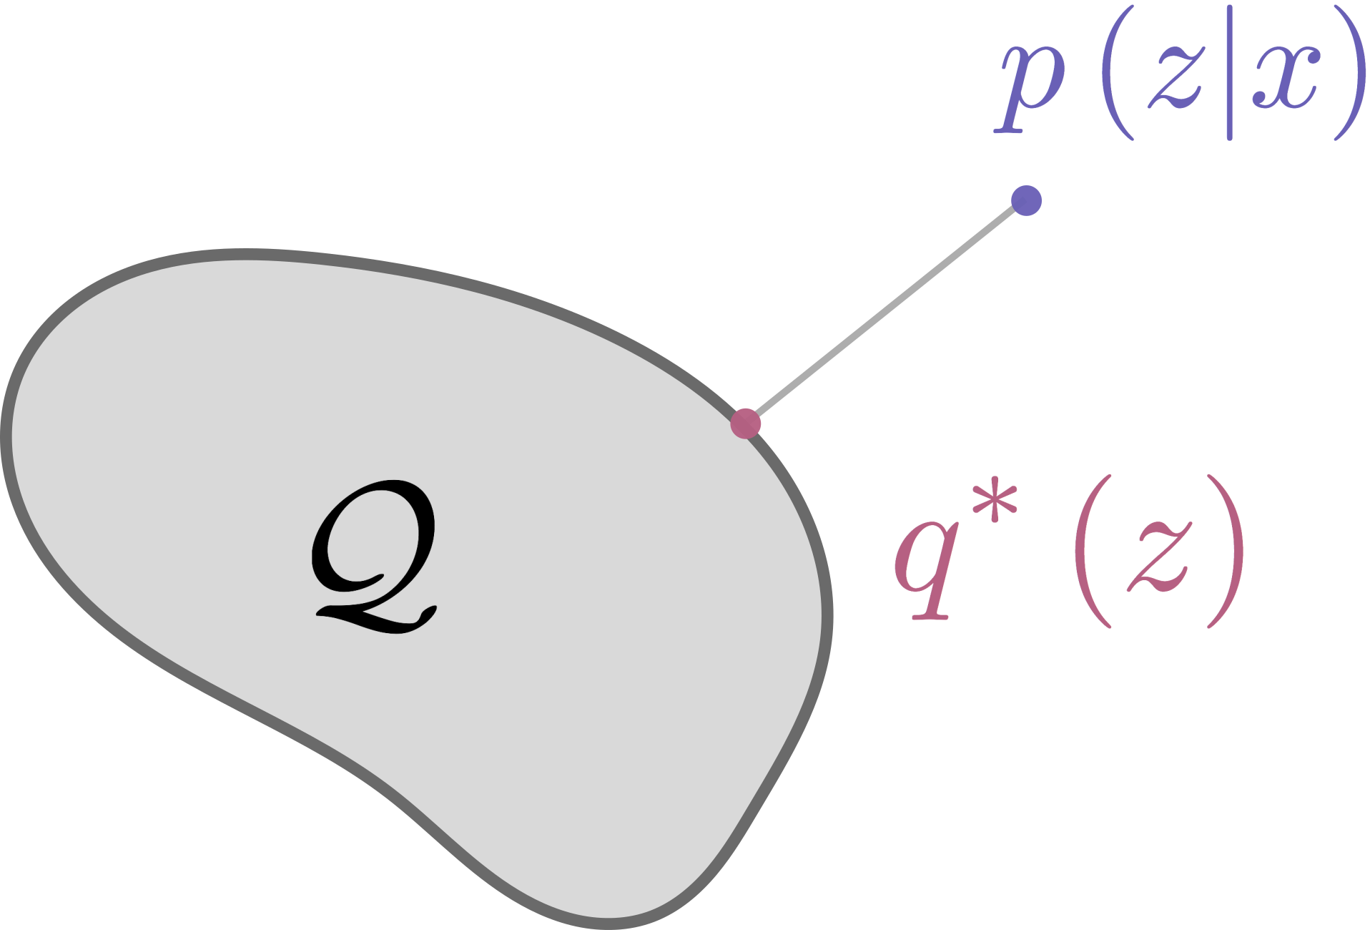
The Variational Idea
Integration → Optimization
Some families are easier to optimize over.
[Trade-off tractability and quality]

Slide 11
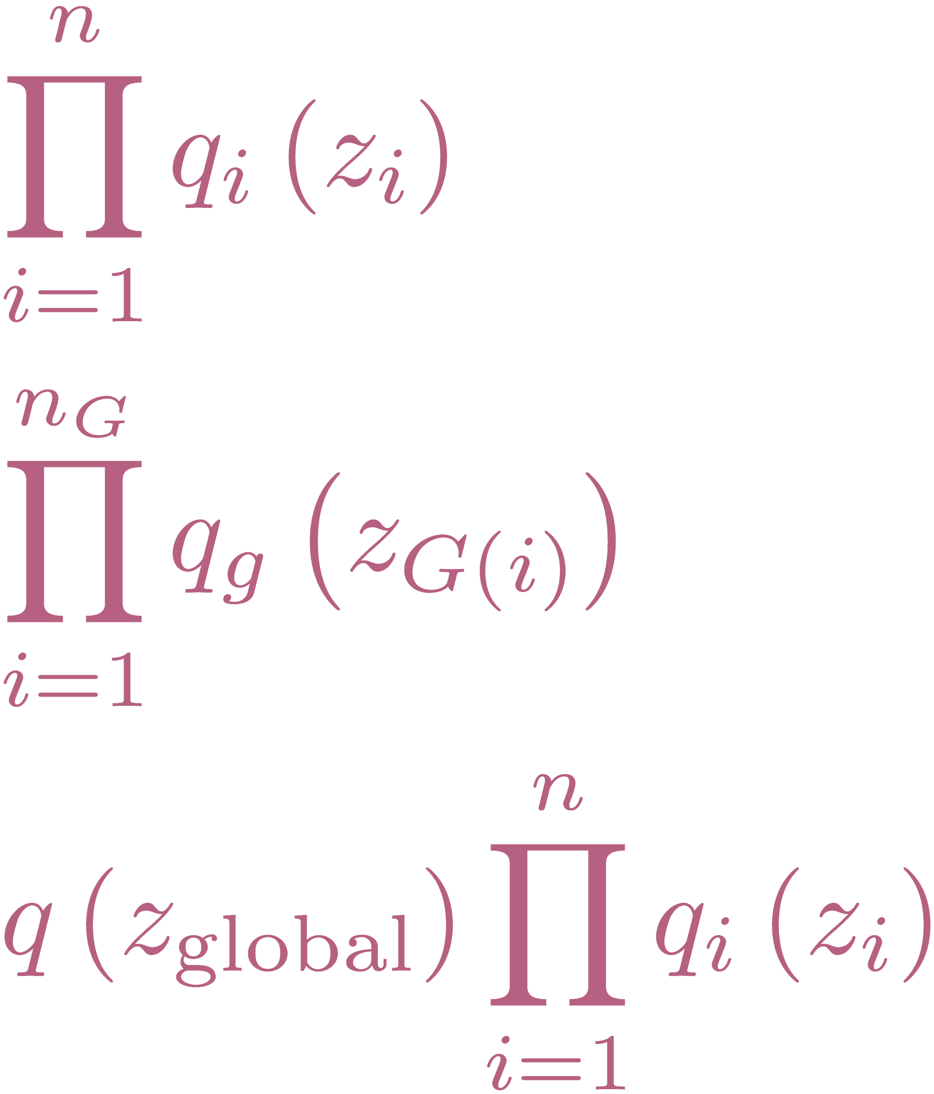

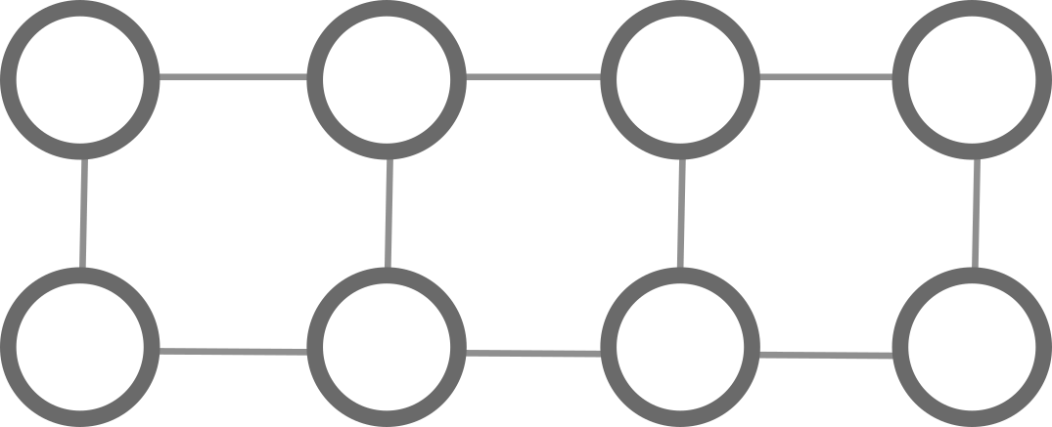
The Variational Idea
Integration → Optimization
Typical choices of
Mean Field

Slide 12
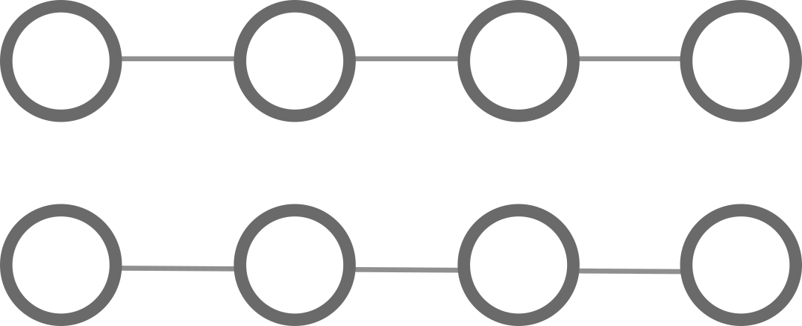
The Variational Idea
Integration → Optimization
Typical choices of
Mean Field
Structured Mean Field

Slide 13

The Variational Idea
Integration → Optimization
Typical choices of
Mean Field
Structured Mean Field
Global / Local factorizations

Slide 14
Optimization
Typical strategies,
Coordinate updates
For large data, only update minibatches (Stochastic Variational Inference)
Coord updates animation

Slide 15
Optimization
Typical strategies,
Coordinate updates
We can’t compute this!
For large data, only update minibatches (Stochastic Variational Inference)
Coord updates animation

Slide 16
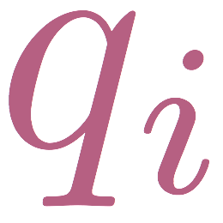
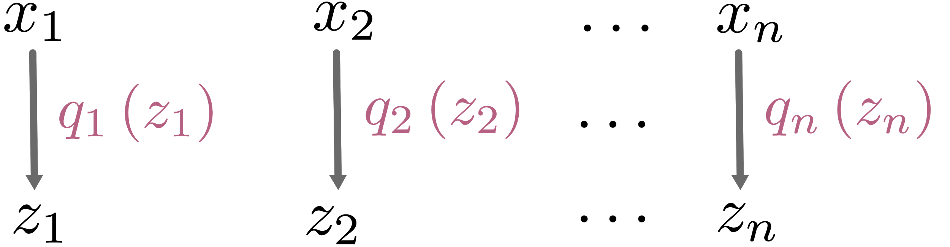
What to do? (1) Amortization
Typically: Coordinate ascent on , updating one at a time
Nonparametric → Number of parameters grows with the data

Slide 17
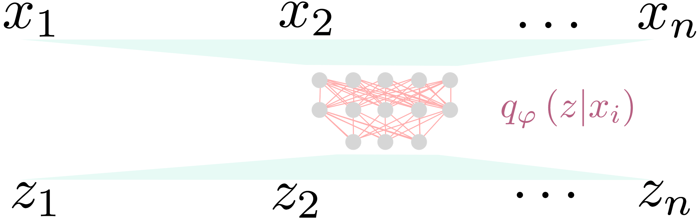
What to do? (1) Amortization
Typically: Coordinate ascent on , updating one at a time
Nonparametric → Number of parameters grows with the data
Instead: Learn a mapping from data to latent variables
Parametric, but very flexible

Slide 18
What to do? (2) Reparameterization
We’ve abandoned mean-field updates
Idea: Directly optimize using noisy gradients
It’s enlightening to analyze different forms of

